Slide 1
Results on expanded dataset
Zheng Lu

Slide 2
New dataset
Dataset has 386 rosettes and 1200 non-rosettes
Experimented on different dataset size:
1.0: train 1063, test 523
0.5: train 527, test 523
0.2: train 203, test 523
0.1: train 100, test 523
0.05: train 53, test 523
0.02: train 28, test 523
0.01: train 10, test 523
All dataset has 1:3 rosette to non-rosette ratio

Slide 3
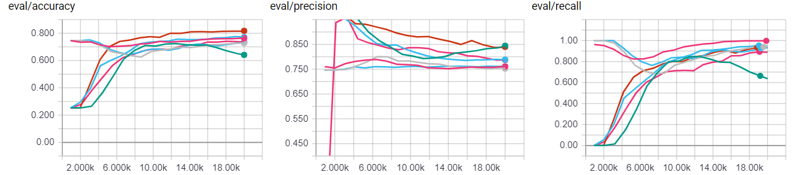
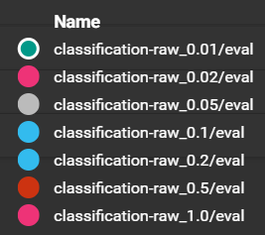
Results on network without transfer learning at 20k training step
Some start at 0.75, some at 0.25, depends on whether network initially classify everything as non-rosette or rosette
All experiments finally has similar accuracy around 0.75
Both precision and recall looks ok

Slide 4
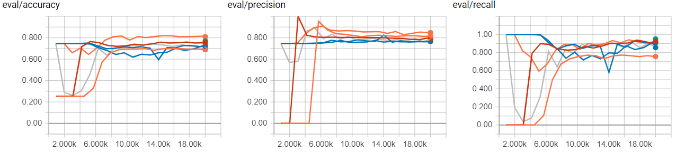
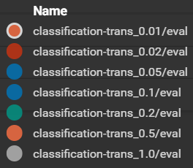
Results on network with transfer learning at 20k training step
Some start at 0.75, some at 0.25, depends on whether network initially classify everything as non-rosette or rosette
All experiments finally has similar accuracy around 0.75
Both precision and recall looks ok
The big leap in precision suggest that some feature that is critical in classification has been learnt.

Slide 5
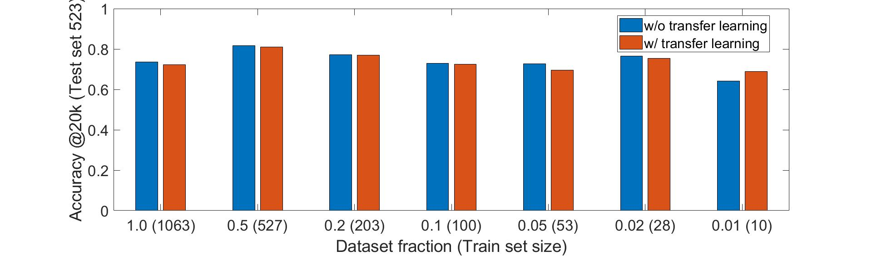
Accuracy vs. dataset size
Average accuracy on network without transfer learning: 0.7412
Average accuracy on network with transfer learning: 0.7377

Slide 6
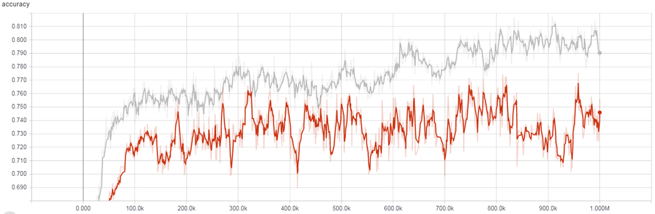
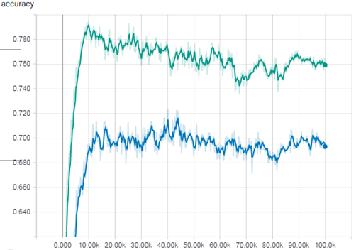
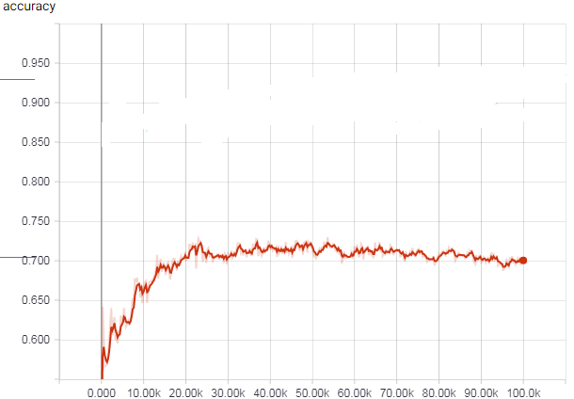
Figures that we should take off the paper
We have these figures when I forget to turn off the update of batch normalization parameters during testing.
It means that we are actually using the testing set to train the network.
We should not use these images in the paper in my opinion.

